Slide 1

Weather Trend Forecasting with Machine Learning
Lachiket Warule
A Data Science Project on Predicting Temperature Trends

Slide 2
Objective
Forecast future temperature trends using machine learning techniques.
Analyze the Global Weather Repository dataset to predict temperature based on various features like location and time.
Evaluate and compare different models: Linear Regression and Holt-Winters Exponential Smoothing.

Slide 3
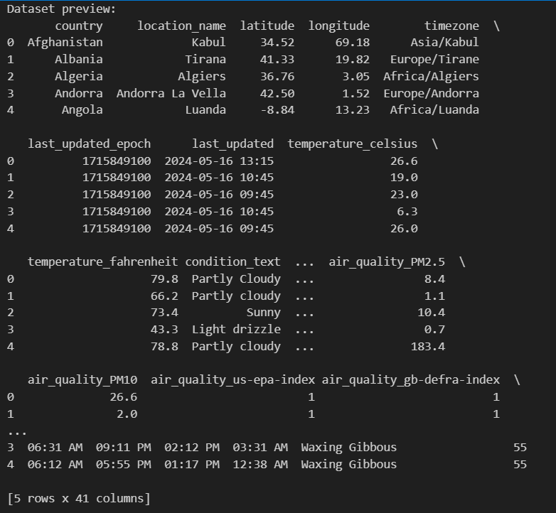
Dataset Overview
Dataset: Global Weather Repository
Key Features:
Temperature (Celsius and Fahrenheit)
Precipitation (mm)
Wind Speed, Humidity, Pressure, Visibility
Time-based features like year, month, day, and hour
Geographic features: Latitude, Longitude

Slide 4
Data Preprocessing
Handling Missing Values: Removed rows with missing values.
Data Normalization: Applied MinMaxScaler to latitude and longitude features.
Outlier Detection: Used Z-score to remove temperature outliers.
Feature Engineering: Extracted time-based features: Year, Month, Day, Hour.

Slide 5
Exploratory Data Analysis (EDA)
Temperature Distribution: Histogram to visualize the distribution of temperature.
Precipitation Distribution: Histogram to visualize precipitation distribution.
Correlation Matrix: Correlation Heatmap to show relationships between weather features.
Insights: Temperature is strongly correlated with humidity.

Slide 6
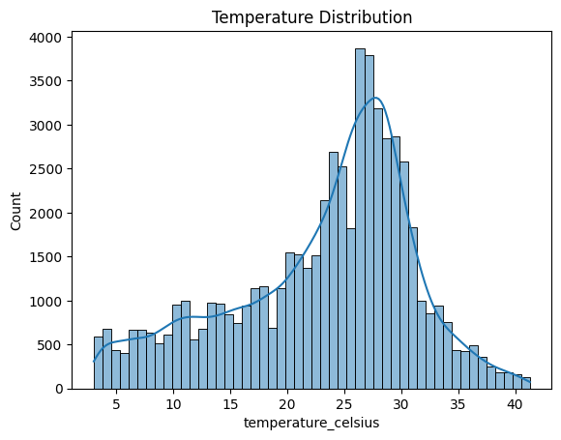
Temperature distribution

Slide 7
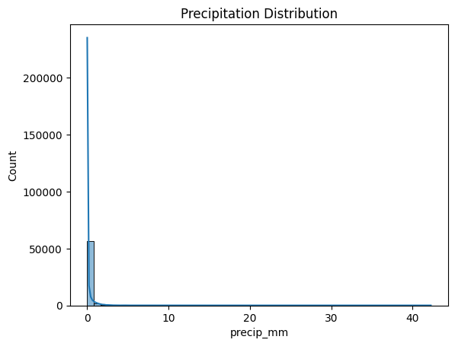
Precipitation distribution

Slide 8
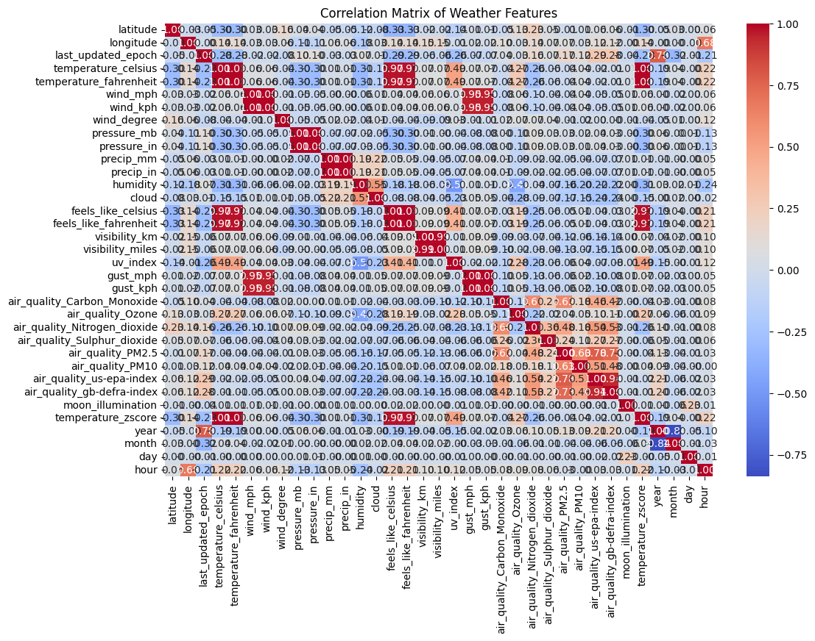
Correlation matrix

Slide 9
Linear Regression Model
Model Overview: Predicts temperature based on time and geographic features.
Evaluation Metrics:
Mean Squared Error (MSE): 63.86
Mean Absolute Error (MAE): 6.31R²: 0.27
Model Insights: The model's performance is poor, as indicated by the low R² value. It suggests the model does not capture temperature trends well.

Slide 10
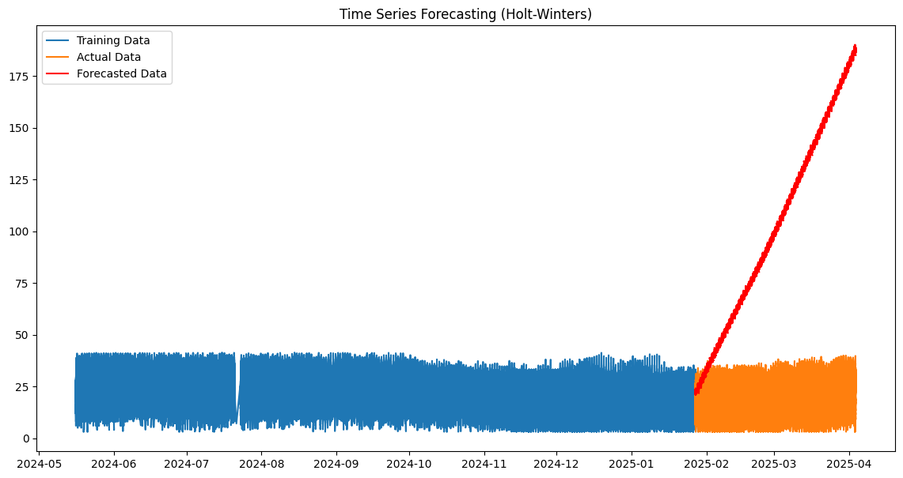

Slide 11
Model Evaluation - Errors
Training Data Errors:
MAE: 6.74
MSE: 71.27
Test Data Errors (Holt-Winters Forecast):
MAE: 82.77
MSE: 9149.77
Insights: Holt-Winters performs better on training data than on the test data.
The forecasted values show significant error on test data.

Slide 12
Key Insights
Linear Regression:
Poor performance due to low R² and high MSE.
Holt-Winters:
Better at capturing seasonal trends but still has high error on test data.
Forecasts perform well on training data but exhibit more error on test data.
Data Insights:
Temperature distribution is spread with some extreme values.
Precipitation is mostly low, with occasional high values.

Slide 13
Conclusion
Summary:
This analysis shows the challenges in predicting weather patterns accurately with basic models like Linear Regression.
Time series models like Holt-Winters provide more accurate forecasts, but there’s room for improvement.
Next Steps:
Explore more advanced models like ARIMA or Facebook Prophet.
Use hyperparameter tuning to improve model performance.

Slide 14
Future Work
Enhance Model Performance: Tune hyperparameters of the Holt-Winters model.
Experiment with advanced time series models.
Include Additional Features: Incorporate more weather features like wind speed, pressure, and humidity.
Model Refinement: Perform feature engineering and evaluate other machine learning models like Random Forest or XGBoost for better performance.

Slide 15

Thank You

